Slide 1
UNIT 2
Chapter 2
Transmission media

Slide 2
Transmission media
Transmission media are actually located below the physical layer and are directly controlled by the physical layer.
A transmission medium can be broadly defined as anything that can carry information
from a source to a destination.
In telecommunications, transmission media can be divided into two broad categories:
guided and unguided. Guided media include twisted-pair cable, coaxial cable, and
fiber-optic cable.

Slide 3
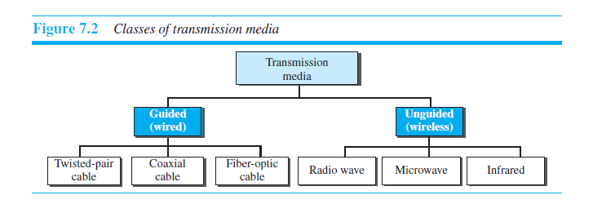

Slide 4
GUIDED MEDIA
Guided media, which are those that provide a conduit from one device to another, include twisted-pair cable, coaxial cable, and fiber-optic cable.
A signal traveling along any of these media is directed and contained by the physical limits of the medium.
Twisted-pair and coaxial cable use metallic (copper) conductors that accept and transport signals in the form of electric current.
Optical fiber is a cable that accepts and transports signals in the form of light.

Slide 5
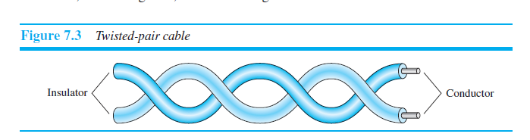
Twisted-Pair Cable

Slide 6
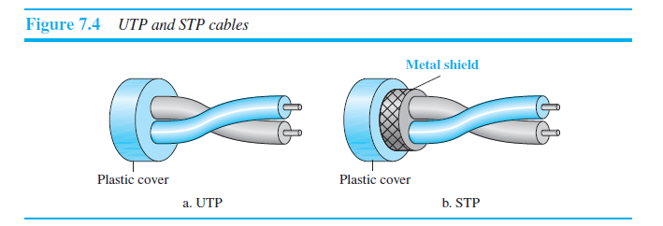
Unshielded Versus Shielded Twisted-Pair Cable

Slide 7
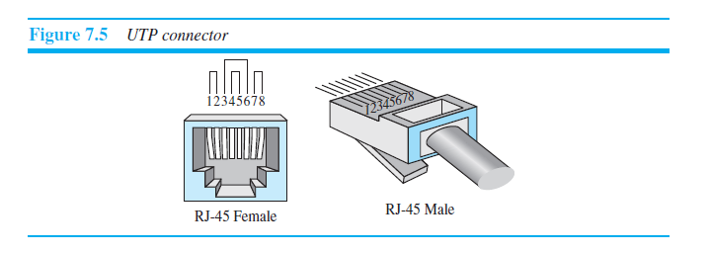
Connectors

Slide 8
Applications
Twisted-pair cables are used in telephone lines to provide voice and data channels.
The local loop—the line that connects subscribers to the central telephone office—commonly consists of unshielded twisted-pair cables.
The DSL lines that are used by the telephone companies to provide high-data-rate connections also use the high-bandwidth capability of unshielded twisted-pair cables.

Slide 9
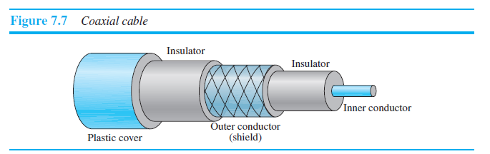
Coaxial Cable

Slide 10
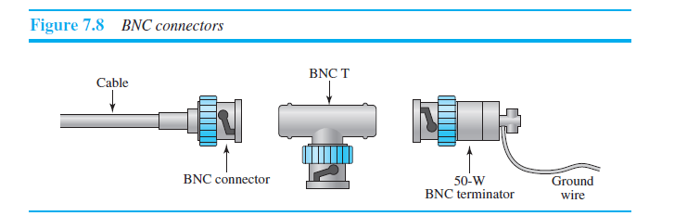
Coaxial Cable Connectors

Slide 11
To connect coaxial cable to devices, we need coaxial connectors.
The most common type of connector used today is the Bayonet Neill-Concelman (BNC) connector.
Figure 7.8 shows three popular types of these connectors: the BNC connector, the BNC T connector, and the BNC terminator.

Slide 12
Applications
Coaxial cable was widely used in analog telephone networks where a single coaxial network could carry 10,000 voice signals.
Later it was used in digital telephone networks where a single coaxial cable could carry digital data up to 600 Mbps.
Cable TV networks also use coaxial cables.
Another common application of coaxial cable is in traditional Ethernet LANs.

Slide 13
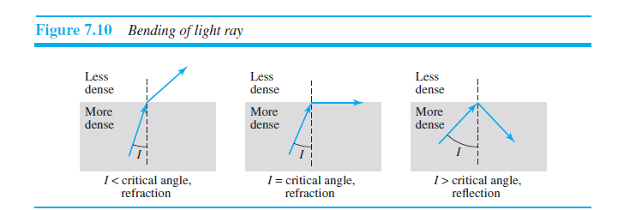
Fiber-Optic Cable

Slide 14
A fiber-optic cable is made of glass or plastic and transmits signals in the form of light.
Light travels in a straight line as long as it is moving through a single uniform substance.
If a ray of light traveling through one substance suddenly enters another substance (of a different density), the ray changes direction. Figure 7.10 shows how a ray of light changes direction when going from a more dense to a less dense substance.

Slide 15
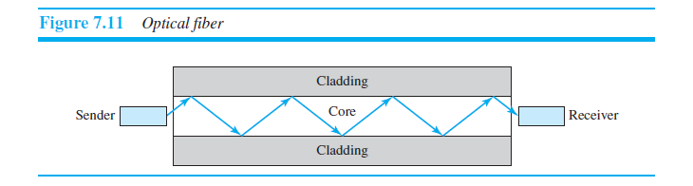

Slide 16
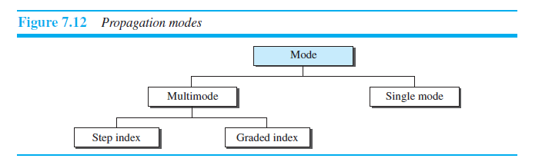
Propagation Modes

Slide 17
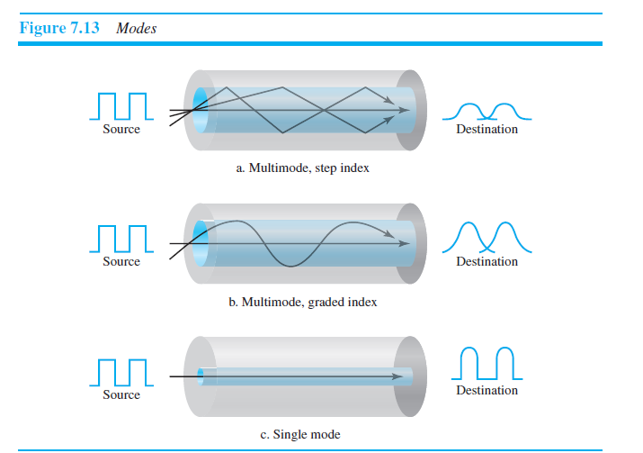

Slide 18
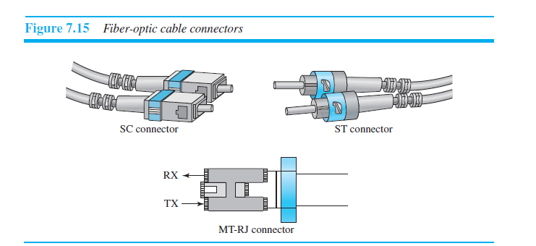
Fiber-Optic Cable Connectors

Slide 19
Applications
Some cable TV companies use a combination of optical fiber and coaxial cable,thus creating a hybrid network.
Local-area networks such as 100Base-FX network (Fast Ethernet) and 1000Base-X also use fiber-optic cable.

Slide 20
Advantages and Disadvantages of Optical Fiber
Advantages
Higher bandwidth. Fiber-optic cable can support dramatically higher bandwidths
Less signal attenuation
Immunity to electromagnetic interference. Electromagnetic noise cannot affect
Resistance to corrosive materials. Glass is more resistant to corrosive materials
Light weight
Greater immunity to tapping.

Slide 21
Disadvantages
Installation and maintenance.
Unidirectional light propagation.
Cost.

Slide 22
UNGUIDED MEDIA: WIRELESS
Unguided medium transport electromagnetic waves without using a physical conductor.
This type of communication is often referred to as wireless communication.
Signals are normally broadcast through free space and thus are available to anyone who has a device capable of receiving them.
Unguided signals can travel from the source to the destination in several ways: ground propagation, sky propagation, and line-of-sight propagation.

Slide 23
In ground propagation, radio waves travel through the lowest portion of the atmosphere,hugging the earth.
In sky propagation, higher-frequency radio waves radiate upward into the ionosphere (the layer of atmosphere where particles exist as ions) where they are reflected back to earth. This type of transmission allows for greater distances with lower output power.
In line-of-sight propagation, very high-frequency signals are transmitted in straight lines directly from antenna to antenna.

Slide 24
The section of the electromagnetic spectrum defined as radio waves and microwaves is divided into eight ranges, called bands, each regulated by government authorities.
These bands are rated from very low frequency (VLF) to extremely high frequency (EHF).
We can divide wireless transmission into three broad groups: radio waves, microwaves,and infrared waves.

Slide 25
Radio Waves
Electromagnetic waves ranging in frequencies between 3 kHz and 1 GHz are normally called radio waves; waves ranging in frequencies between 1 and 300 GHz are called microwaves.
Radio waves, for the most part, are omnidirectional.
When an antenna transmits radio waves, they are propagated in all directions.
This means that the sending and receiving antennas do not have to be aligned.
A sending antenna sends waves that can be received by any receiving antenna..

Slide 26
The omnidirectional property has a disadvantage,too.
The radio waves transmitted by one antenna are susceptible to interference by another antenna that may send signals using the same frequency or band.
Radio waves, particularly those waves that propagate in the sky mode, can travel long distances.
This makes radio waves a good candidate for long-distance broadcasting such as AM radio.

Slide 27
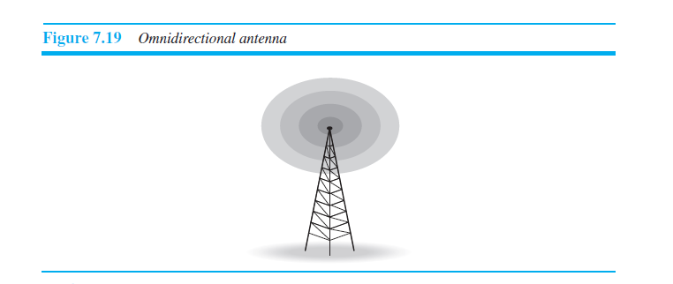
Omnidirectional Antenna

Slide 28
Applications
The omnidirectional characteristics of radio waves make them useful for multicasting,in which there is one sender but many receivers. AM and FM radio, television, maritime radio, cordless phones, and paging are examples of multicasting.

Slide 29
Microwaves
Electromagnetic waves having frequencies between 1 and 300 GHz are called microwaves.
Microwaves are unidirectional.
When an antenna transmits microwaves, they can be narrowly focused.
This means that the sending and receiving antennas need to be aligned.
The unidirectional property has an obvious advantage. A pair of antennas can be aligned without interfering with another pair of aligned antennas.

Slide 30
Characteristics of microwave propagation:
Microwave propagation is line-of-sight. Since the towers with the mounted antennas need to be in direct sight of each other, towers that are far apart need to be very tall.
Very high-frequency microwaves cannot penetrate walls.
The microwave band is relatively wide, almost 299 GHz. Therefore wider subbands can be assigned, and a high data rate is possible.
Use of certain portions of the band requires permission from authorities.

Slide 31
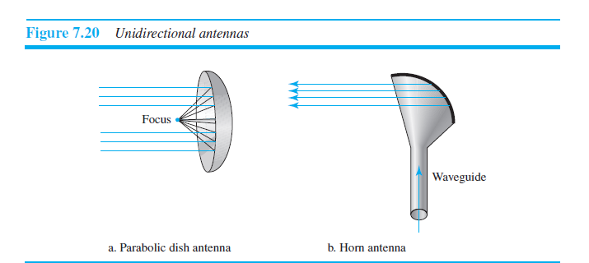
Unidirectional Antenna

Slide 32
Applications
Microwaves are used for unicast communication such as cellular telephones, satellite networks, and wireless LANs.

Slide 33
Infrared
Infrared waves, with frequencies from 300 GHz to 400 THz (wavelengths from 1 mm to 770 nm), can be used for short-range communication.
Infrared waves, having high frequencies, cannot penetrate walls.
This advantageous characteristic prevents interference between one system and another; a short-range communication system in one room cannot be affected by another system in the next room.

Slide 34
Applications
Infrared signals can be used for short-range communication in a closed area using line-of-sight propagation.
The Infrared Data Association (IrDA), an association for sponsoring the use of infrared waves, has established standards for using these signals for communication between devices such as keyboards, mice, PCs, and printers.

